Slide 1

Beathaichean fiadhaich na h-Alba
Notes:
Scottish wild animals

Slide 2
Dè tha seo?
Seo fiadh.
Notes:
What is this? This is a deer.

Slide 3
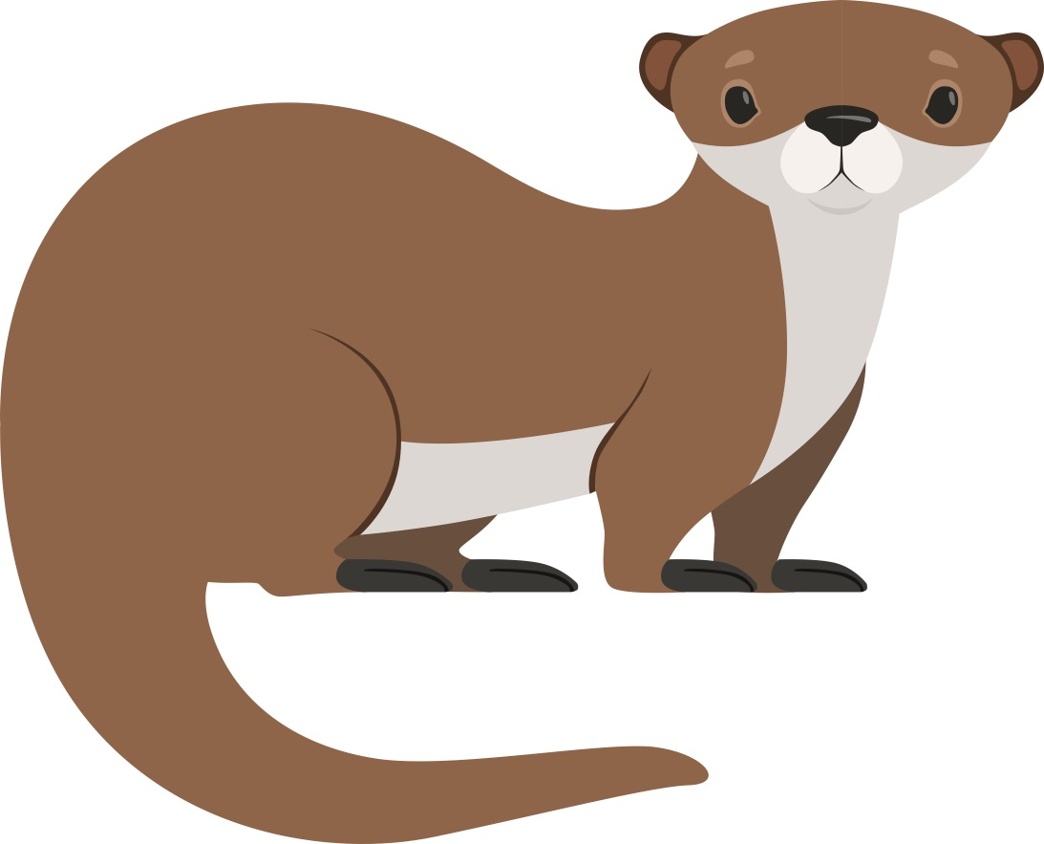
Dè tha seo?
Seo biast-dhubh.
Notes:
What is this? This is an otter.

Slide 4
Dè tha seo?
Seo feòrag.
Notes:
What is this? This is a squirrel.

Slide 5
Dè tha seo?
Seo geàrr.
Notes:
What is this? This is a hare.

Slide 6
Dè tha seo?
Seo ròn.
Notes:
What is this? This is a seal.

Slide 7
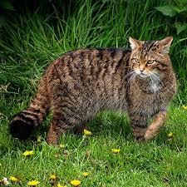
Dè tha seo?
Seo cat fiadhaich na h-Alba.
Notes:
What is this? This is a Scottish wildcat.

Slide 8
Dè tha seo?
Notes:
What is this?

